Slide 1

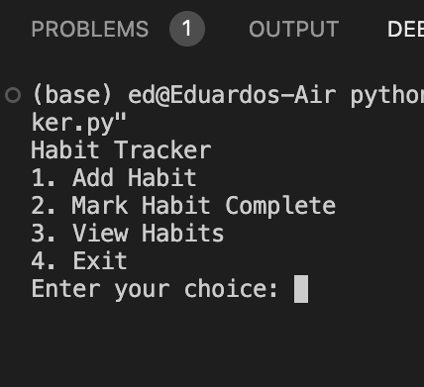
Habit Tracker
Made by: Eduardo Silva and Giorgio De Francesco
This app empowers you to build positive habits and achieve your personal goals. Track your daily routines, monitor progress, and stay motivated on your journey to self-improvement.

